Slide 1
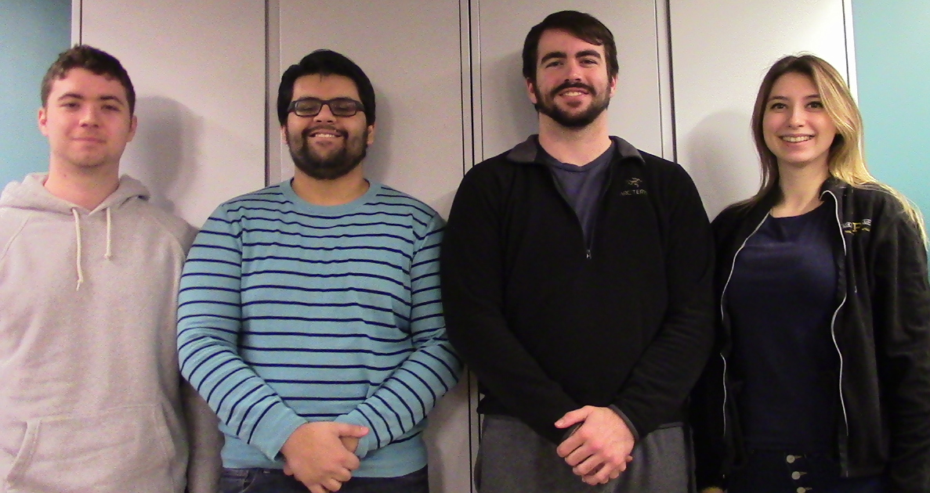

ECE 477 FINAL REVIEW: TEAM 2
<Add team picture or relevant project picture here>
Notes:
Speaker - Evan

Slide 2
OUTLINE
Project Overview
Block Diagram
Design Challenges
Individual Contributions
Project Demonstration
Questions
Notes:
Speaker - Evan

Slide 3
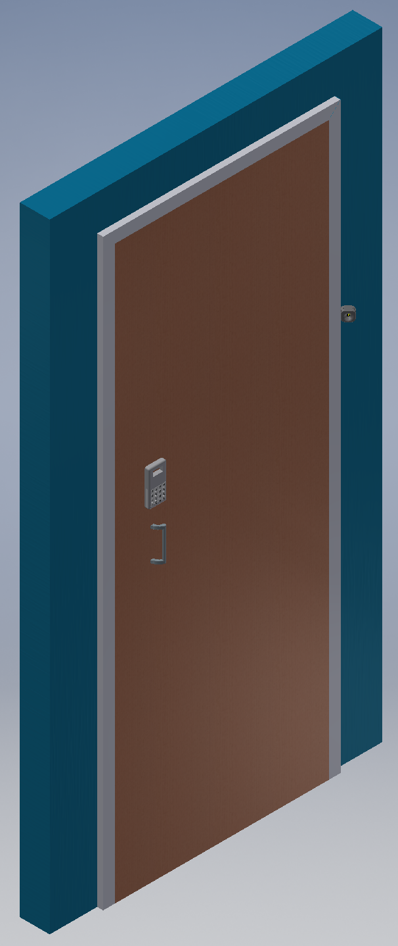
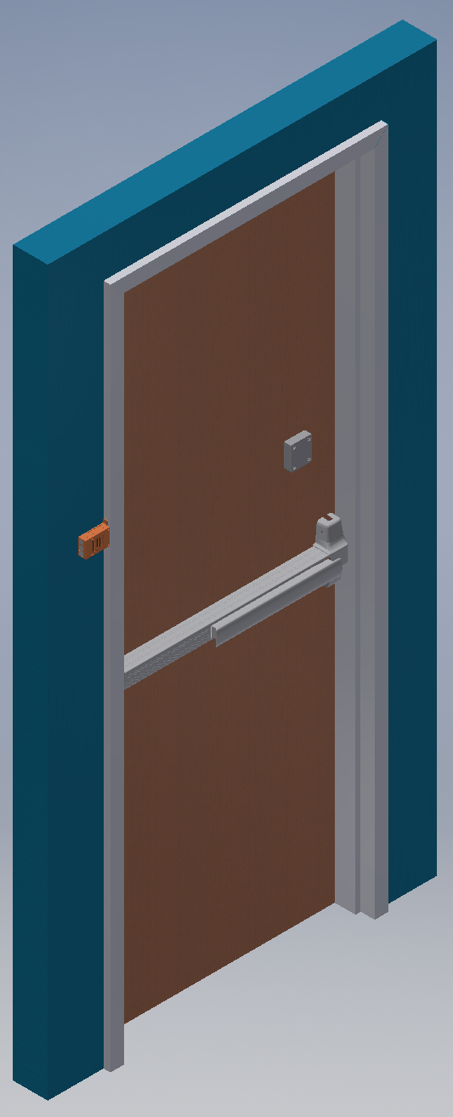
PROJECT OVERVIEW
The Guard DAWG System is a door mounted security system
Uses face recognition to allow entry into a residential or commercial property
Transmits images to a server, and permits entry based on similarity score results
User registration occurs on server, so no one can hijack registration from the keypad side
Notes:
Speaker - Evan

Slide 4
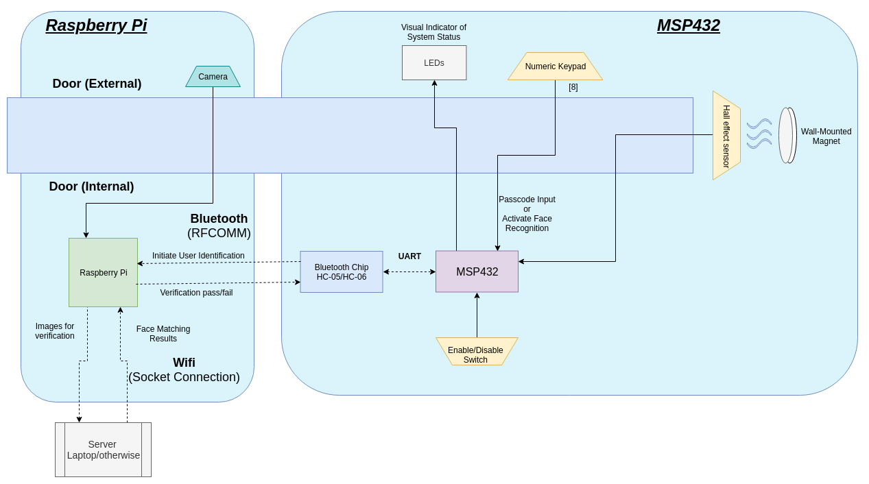
BLOCK DIAGRAM - Guard DAWG System
Notes:
Ian

Slide 5
DESIGN CHALLENGES
Software Integration debugging
general timing issues (data transfer via UART, Bluetooth, etc.)
waiting for the interrupt to finish
interrupt overlapping
Volatile memory on lab machines
lost some code in the process
forced to use Git (actually a good thing)
Programming the board
programming header issues related to PCB design
Power regulation
Linear IC proved to be a bit more finicky than expected, more noisy and harder to route
Notes:
Speaker - Vika, Yash

Slide 6
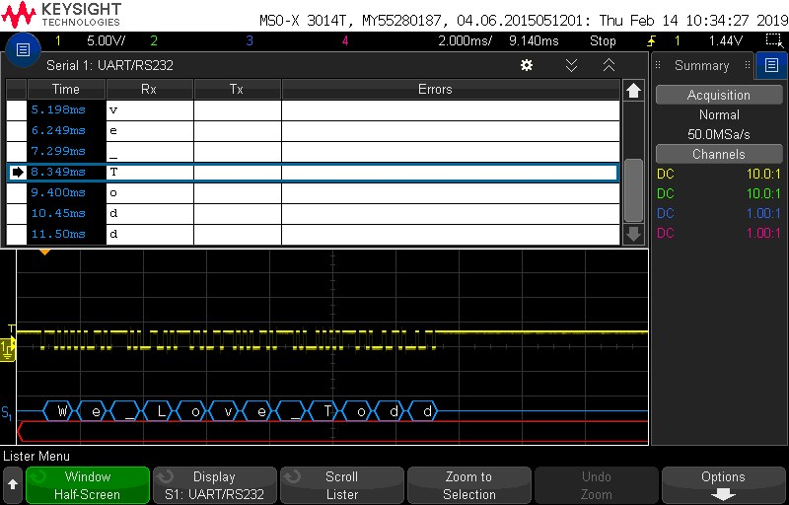
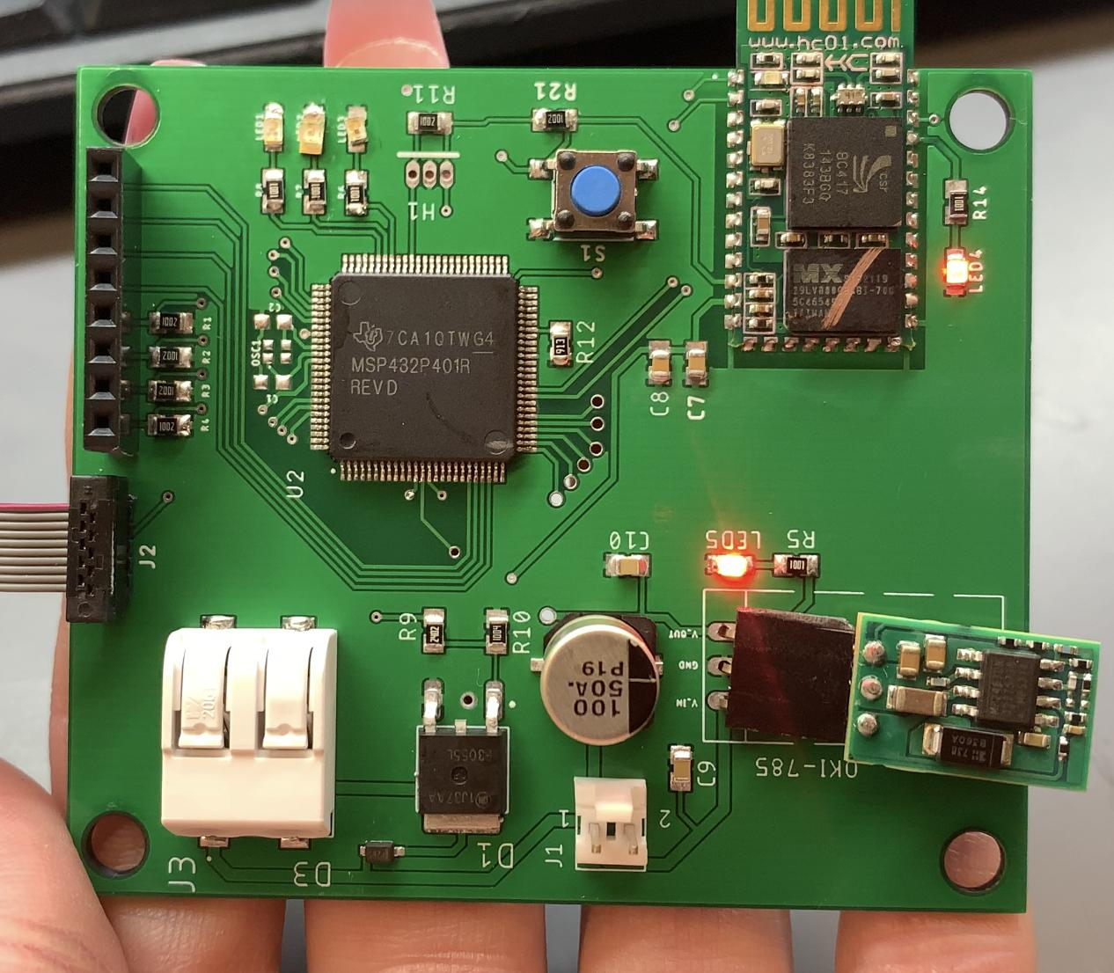
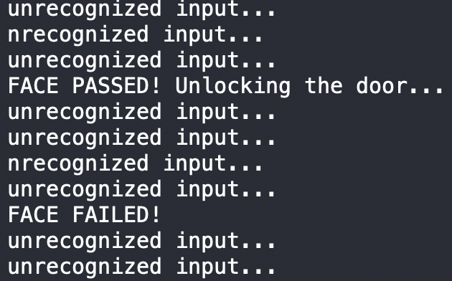
INDIVIDUAL CONTRIBUTIONS
Viktoryia Zhuleva - Systems Lead
Responsible for main frame of the Embedded Systems code (MSP 432) as well as device-specific driver code for HC-05 Bluetooth module (write + debug + test)
Soldered final PCB (test board + program MSP432). In the process resoldered a few burned components (HC-05, LEDs) due to the component failure during testing phase
Responsible for system integration with Software Lead. Developed a communication interface between system components connected via Bluetooth (board and Pi)
Notes:
Speaker - Vika

Slide 7
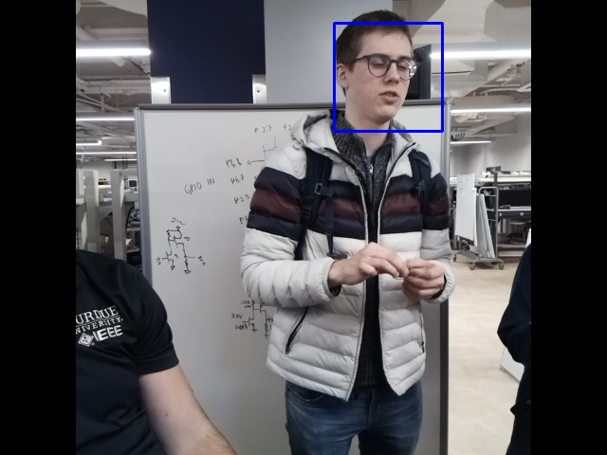
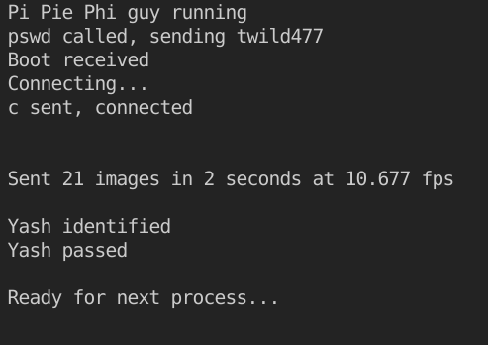
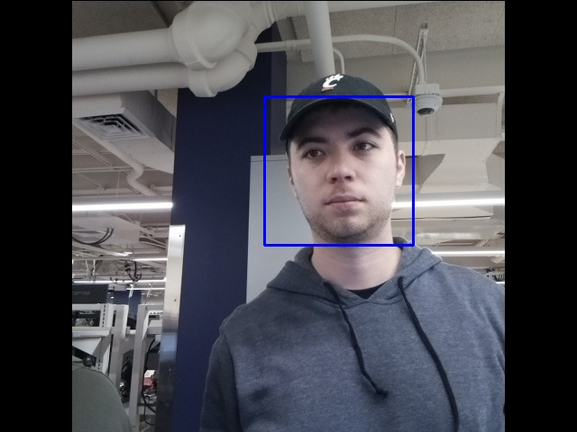
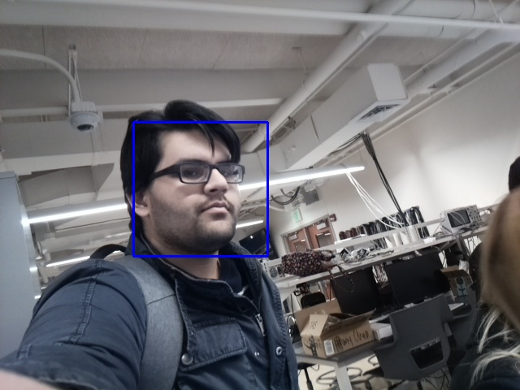
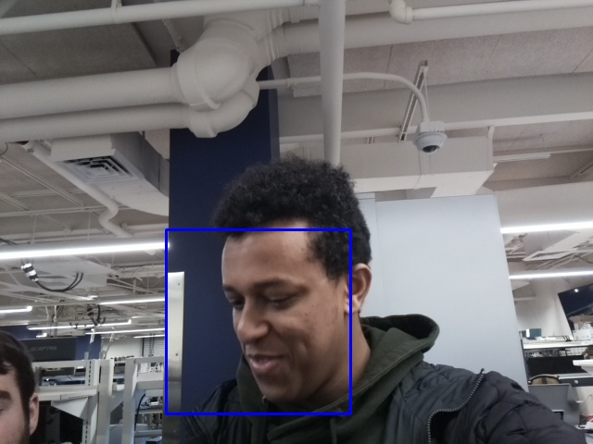
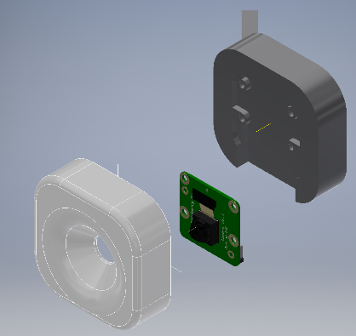
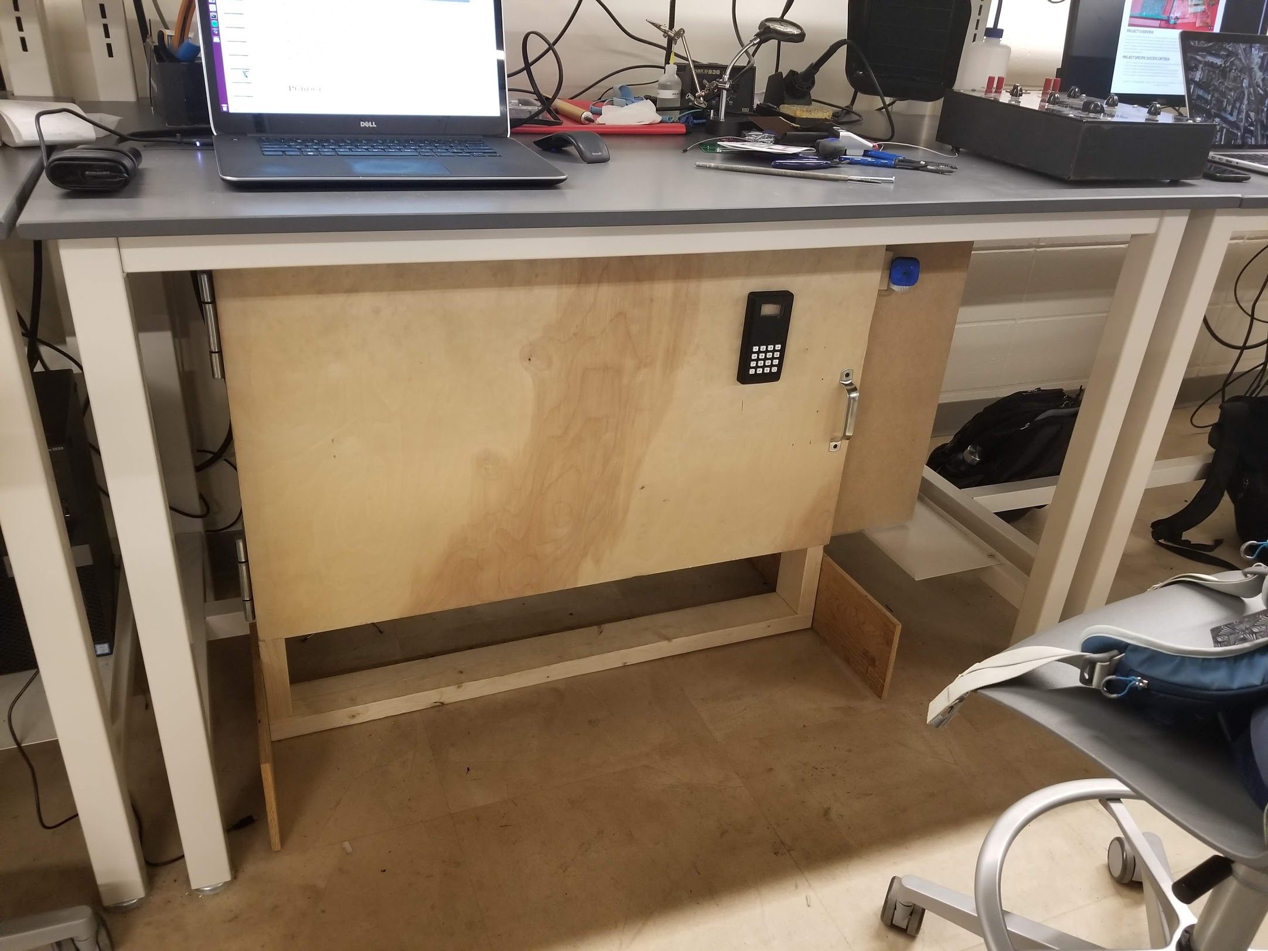
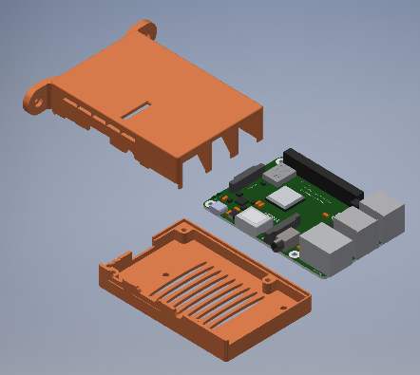
INDIVIDUAL CONTRIBUTIONS
Ian Sibley - Software Lead
Integrated a Raspberry Pi camera and tested transmission speeds through various configurations
Tested several facial recognition structures for both speed and ease of application integration
Resized and assembled the door, as well as designing and 3D printing the Pi Camera and Raspberry Pi enclosures.
Discussed Bluetooth structure, configured Pi side interfacing and a test script, and aided MSP432 connecting
Notes:
Ian

Slide 8
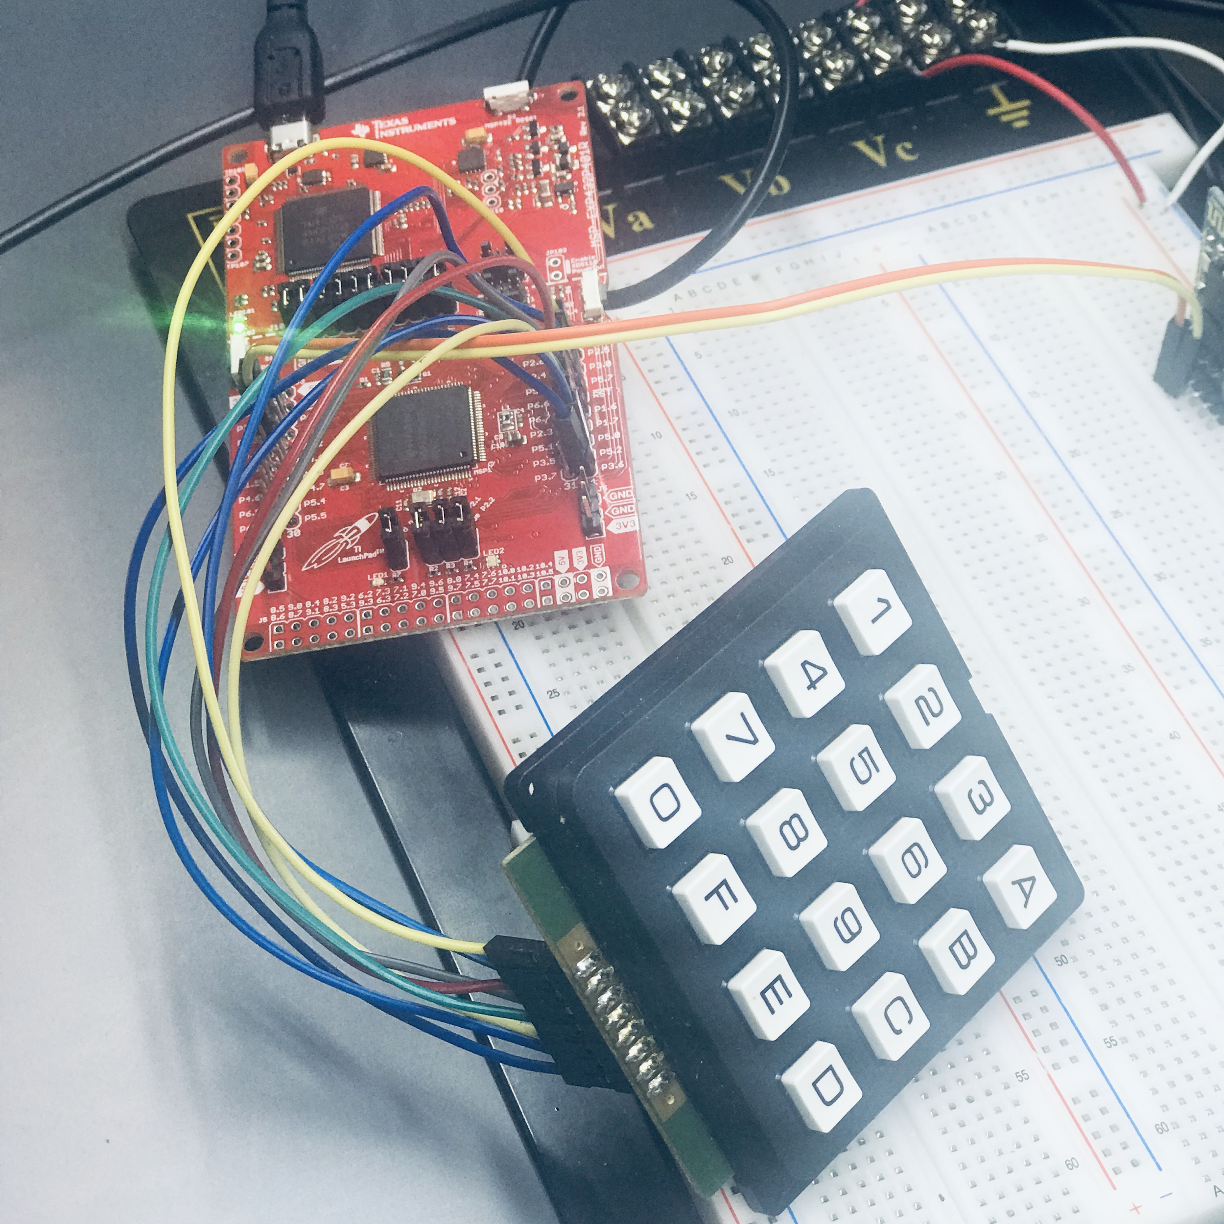
INDIVIDUAL CONTRIBUTIONS
Evan Miller - Team Leader
Responsible for interfacing the MSP432 with several electrical components (Keypad, Hall Effect sensor, LEDs, MOSFET) internal processes (Timer modules, UART Communication)
Developed main algorithm for locking and unlocking the door by using facial recognition or a password entered in on the keypad

Slide 9
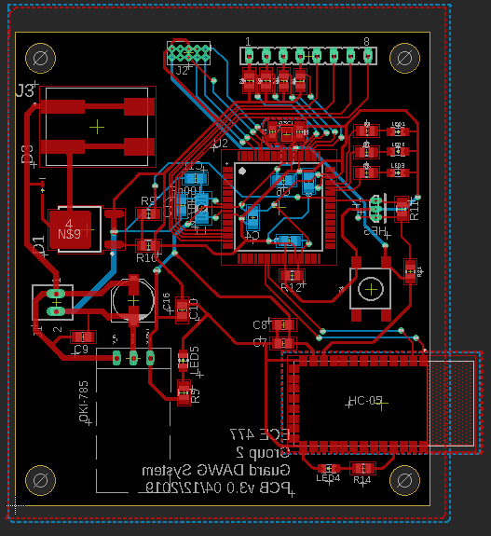
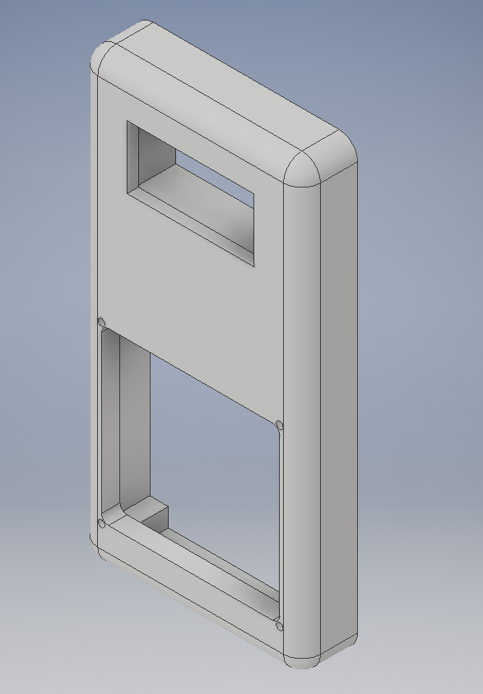
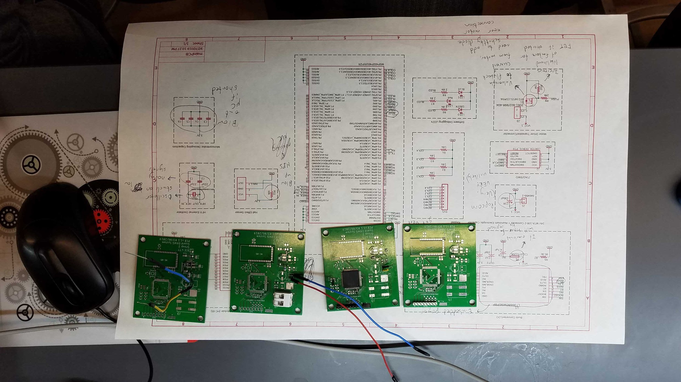
INDIVIDUAL CONTRIBUTIONS
Yash Nain - Hardware Lead
Responsible for hardware design, made each iteration of schematic and layout in Eagle
Performed block-by-block testing for each component on PCB
Started by testing motor driver layout
Moved onto power systems
Then tested microcontroller programming
Designed housing for PCB and keypad on door

Slide 10
PROJECT DEMONSTRATION
PSSCs:
An ability to read video frames from an embedded camera at 4 frames per second.
An ability to receive a password from a numeric keypad.
An ability to communicate through UART to receive user verification.
An ability to interface with a motor driver IC.
An ability to process image data to recognize a registered face.
Project video: https://engineering.purdue.edu/477grp2/media/media.html

Slide 11
Questions?

